Slide 1
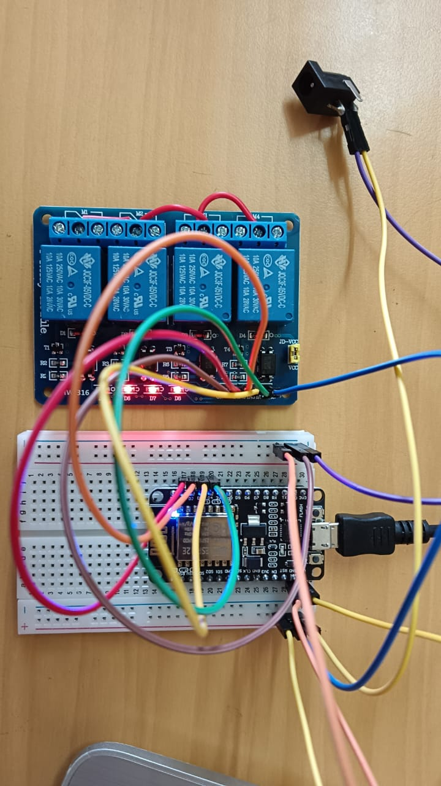
Smart Home Automation using Wi-Fi
Home Appliance Control
with ESP8266 Microcontroller
Presented by: Aaska Pandey Year: 3rd

Slide 2
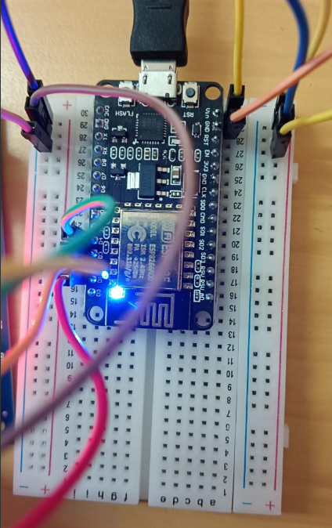
Introduction: Building a Smart Home Foundation
What is a Smart Home?
A home that integrates connected devices to automate and simplify daily tasks, bringing convenience, energy efficiency, and remote access right to your fingertips.
Why the ESP8266?
It is a cheap, small, and powerful Wi-Fi-enabled microcontroller.
It can easily host a tiny web server, eliminating the need for a separate, expensive smart-home hub.
Project Essence
Control up to four light bulbs through a responsive web-based interface accessible via any mobile device or laptop on the local Wi-Fi network.

Slide 3




Defining the Project Objectives
This project aims to demonstrate a core concept in the Internet of Things (IoT): practical, local device control.
Primary Goal: Remote Control
User-Friendly Interface
Safe Mains Control
Provide a simple, intuitive, and responsive control panel that displays the real-time status (ON/OFF) of each controlled appliance.
Demonstrate a practical IoT application that safely switches high-voltage mains power using a low-voltage relay module, ensuring proper isolation.
Enable remote ON/OFF control of up to four independent light bulbs via a web interface accessible from mobile phones and laptops.
Our success depends on the webpage loading reliably and each bulb switching independently with immediate feedback in the UI.

Slide 4
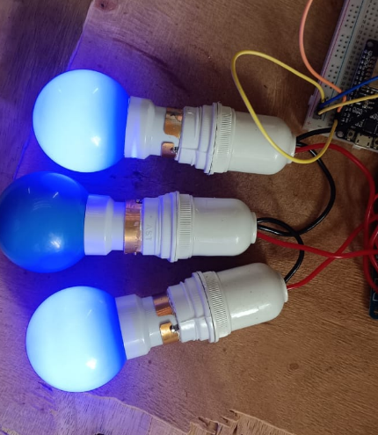
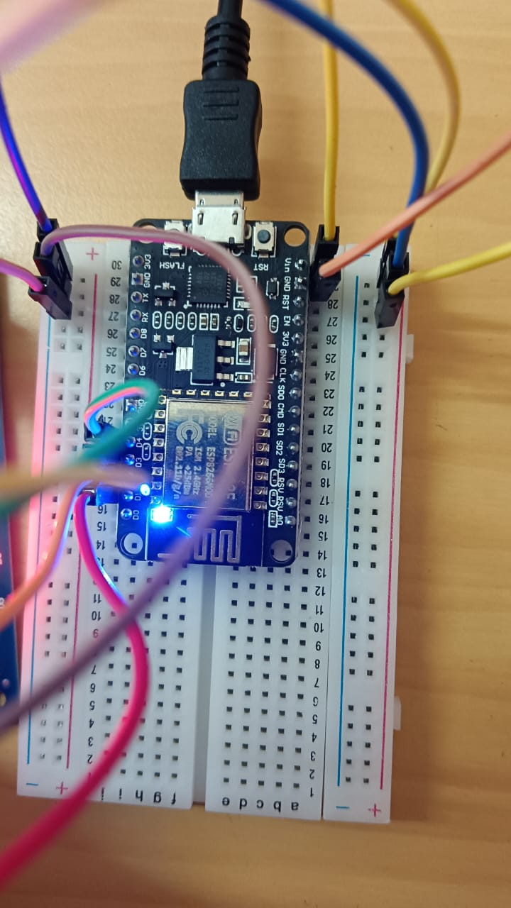
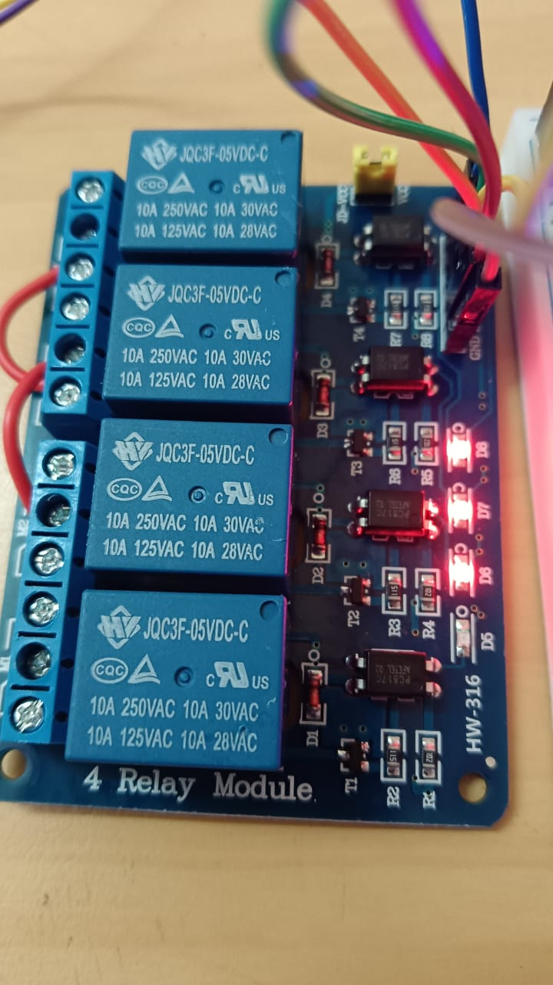
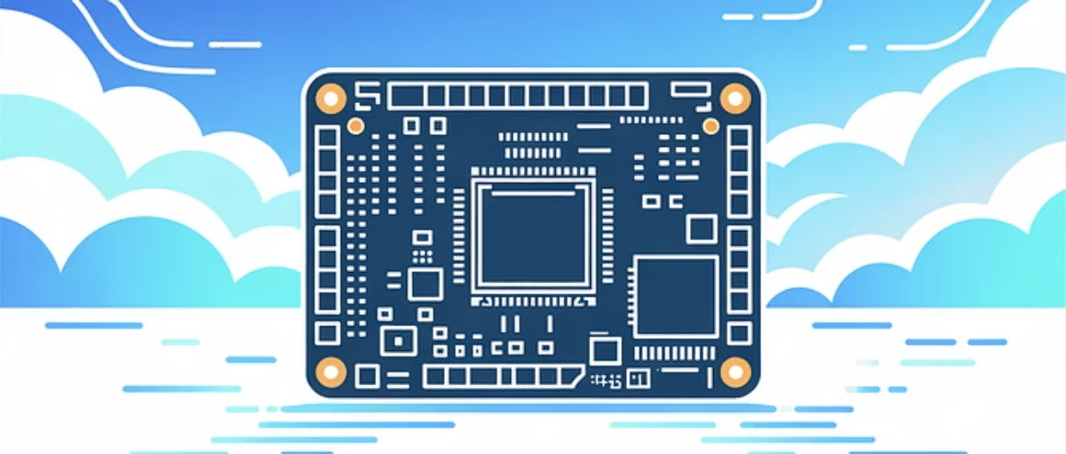
Essential Components for the Controller
The build relies on low-cost, readily available components, making it an excellent beginner project.
ESP8266 Microcontroller
Typically a NodeMCU or WeMos board, serving as the brain
and Wi-Fi interface.
4-Channel Relay Module
Critical safety component to isolate the low-voltage ESP8266 from the high-voltage mains power supply.
Power Supply & Wiring
A stable 5V DC adapter for the ESP8266, along with a DC jack, breadboard, and jumper wires for prototyping.
Light Bulbs (x4)
Standard LED or incandescent bulbs to be controlled via the relays.

Slide 5
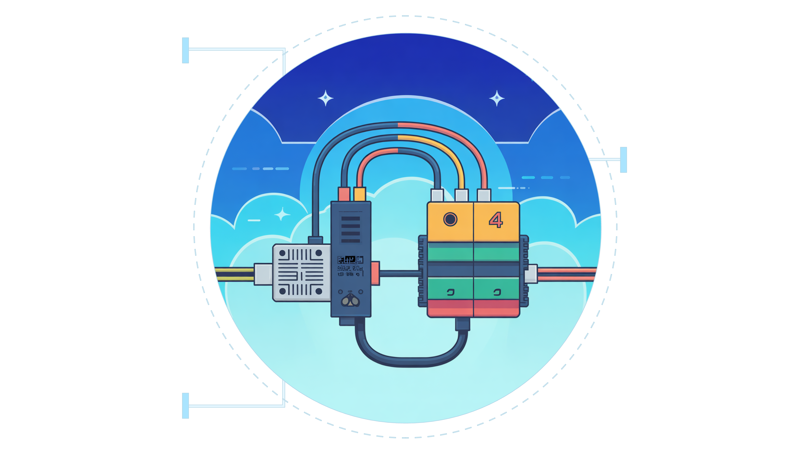
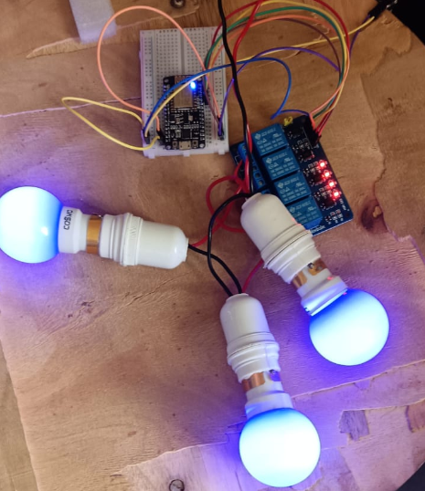
Wiring the Components: The Circuit Diagram
Safety is paramount. The low-voltage control signals from the ESP8266 must be completely isolated
from the mains power that controls the bulbs.
ESP8266
Low-voltage control
signals D1–D4
4-Channel Relay
Opto-isolated inputs
IN1–IN4
Light Bulbs
Four AC mains loads,
separated

Slide 6





Understanding the Working Principle
The automation process follows a precise five-step sequence, managed entirely on your local area network (LAN).
Network Connection
The ESP8266 first initializes and connects to your pre-configured home Wi-Fi network.
Web Server Activation
A tiny, self-contained web server starts running on the ESP8266, ready to serve the control interface.
User Interaction
A user opens the control page via the ESP8266's IP address and clicks an ON/OFF button.
Relay Control
The ESP8266 server receives the request, updates the digital output pin (GPIO), which toggles the relay state.
Physical Action
The relay switches, either powering or cutting power to the bulb, and the web UI updates for real-time status reflection.

Slide 7
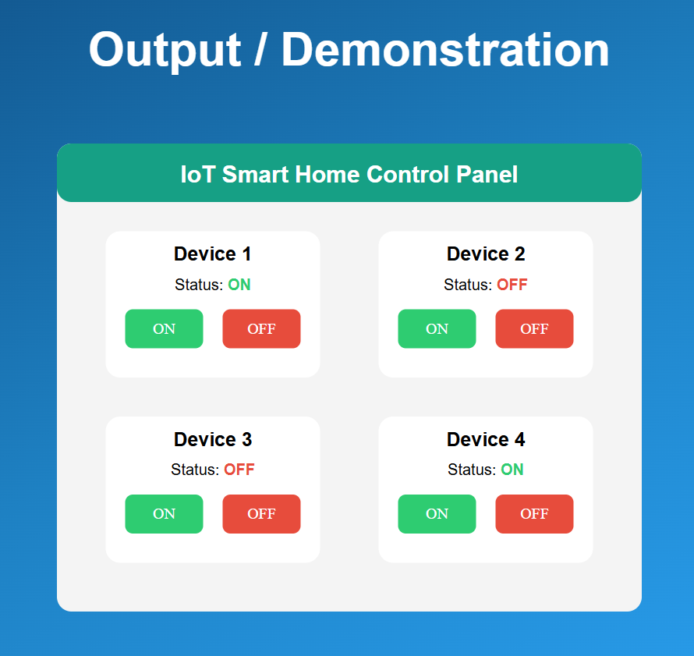
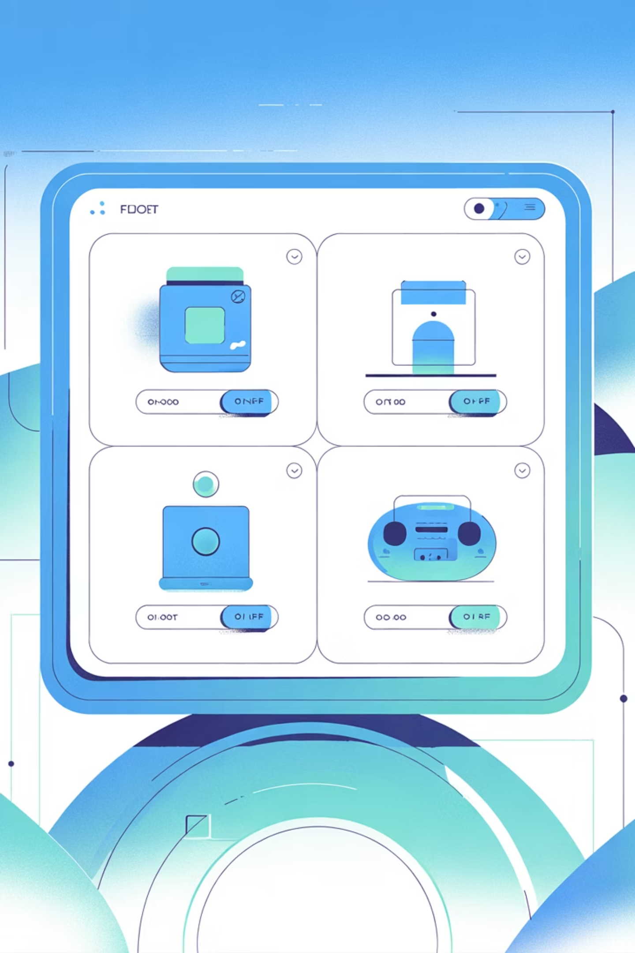






Demonstration and Live Output
Accessing the Control Panel and Real-Time Feedback
Upon successful boot, the ESP8266 prints its assigned local IP address (e.g., http://192.168.1.100) to the serial monitor. This IP is then used by the client device.
Responsive UI
Immediate Response
The HTML interface adapts to different screen sizes, ensuring accessibility on both mobile and desktop devices.
The connection is local and fast, resulting in negligible latency between a click and the bulb switching state.
Live Status
The web page reloads the current status, providing immediate visual feedback on the state of the physical device.

Slide 8
Advantages
This project serves as an extensible foundation for much more complex home automation systems.
Key Advantages
Cost-Effective: Uses inexpensive, widely available IoT components.
Local Control: Operates without reliance on external cloud servers, maintaining privacy and speed.
Scalable: Easily expanded to control more appliances or integrate additional sensors (temperature, motion, etc.).

Slide 9


Project Conclusion:
Practical Demonstration
We successfully demonstrated a practical, Wi-Fi-enabled control system for home lighting using a web-based UI and safe relay switching.
Key Takeaway
The ESP8266 offers a low-cost, extensible, and educational platform for experimenting with real-world smart-home solutions and more complex IoT projects.

Slide 10
THANK YOU

